Slide 1

BSD UNIX FreeBSD - OpenBSD
Presented by: Majda ALLANI

Slide 2
Description
BSD: Berkeley Software Distribution
UNIX Operating System
Written in C
Founded in1977
By the Computer Systems Research Group (CSRG) of the University of California, Berkeley
Notes:
It is Historically a closed source, and had a gradual transition to free software from 1991 on.

Slide 3


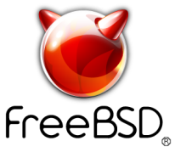
Historical context
BSD has been considered a branch of Unix
Latest release: 4.4-BSDLite2 in1995
BSD has been the base of a large number of operating systems ( BSD descendants):
Notes:
It was the Latest release from Berkeley after which the CSRG was dissolved and development of BSD at Berkeley ceased.
Then came the BSD descendants which are derived from the original BSD code.

Slide 4
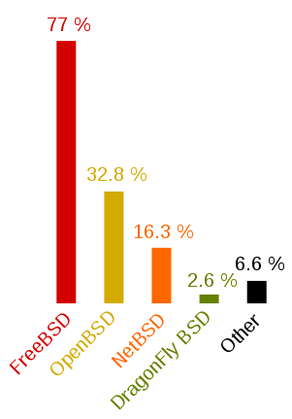
The proportion of users of each BSD variant
BSD usage survey in 2005
Each participant was permitted to indicate multiple BSD variants.[1]
[1] https://en.wikipedia.org/wiki/Berkeley_Software_Distribution

Slide 5

FreeBSD
Is an open source general purpose Operating System
Released in 1993
Aims for maximum performance
Latest release in 2015 (version 10.2)
Notes:
It is free
It was created after a group of 386BSD users decided to branch out on their own and create FreeBSD
Today FreeBSD is the most widely used open-source BSD distribution, accounting for more than three-quarters of all installed systems running open-source BSD derivatives.

Slide 6

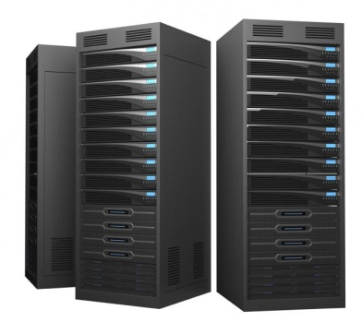

Marketing target
Desktop
Server
Embedded systems

Slide 7
Installation FreeBSD 10.2
Can be downloaded for free from: http://www.freebsd.org
Support for multiple platforms: IA-64, I386, SPARC64, PowerPC, PowerPC64, AMD64
A FreeBSD installation will require a minimum: [2]
1GB of RAM
20 GB of free hard drive space
[2] https://www.freebsd.org/doc/handbook/bsdinstall-hardware.html
Notes:
IA-64: developed by Intel
I386 : developed by Intel
SPARC64: Fabricated by Fujitsu and developed by HAL Computer Systems
PowerPC64: IBM
AMD: Advanced Micro Devices

Slide 8
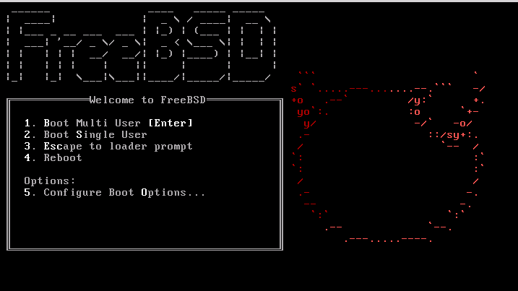
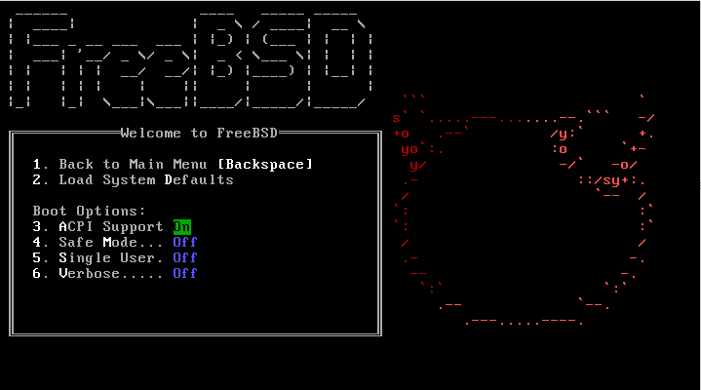
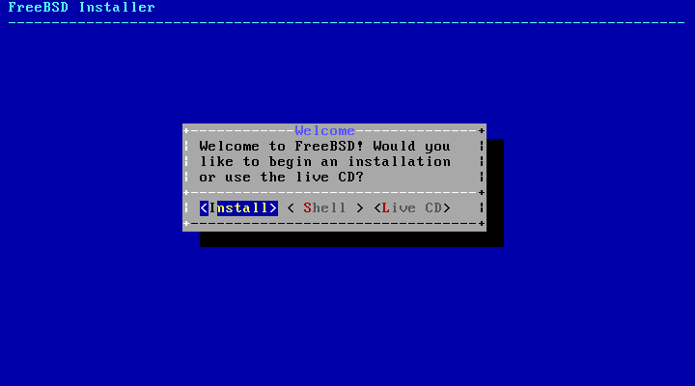
Installation screen shots

Slide 9
Timeline
Release year | Version
1993 | 1.0
1994 | 2.0
1997 | 2.2
Release year | Version
2014 | 9.3
2014 | 10.1
2015 | 10.2
2016 | 10.3
2016 | 11
1998 | 3.0
2000 | 4.0
2003 | 5.0
2005 | 6.0
2008 | 7.0
2010 | 8.1
2011 | 8.2
Old version | Older version, still supported | Current version | Future release
2013 | 9.2
2014 | 10.0

Slide 10
FreeBSD Success
Used by many IT companies: IBM, Nokia to build their product
Certain parts of Apple’s Mac OS operating system are based on FreeBSD
PSP3 operating system also borrows certain components from FreeBSD
PSP4 operating system is derived from FreeBSD 9
Netflix, WhatsApp are also examples of big, successful companies which are running FreeBSD

Slide 11
OpenBSD
Is an open source general purpose Operating System
Released in 1996
Aims for maximum security
Latest release in 2015 (version 5.8)
Notes:
Free source code
Unix-like operating system
It was forked from NetBSD by project leader Theo de Raadt in late 1995. He is co-founder of NetBSD but he was asked to resign from his position as a senior developer and member of the NetBSD core team.
OpenBSD's security enhancements, built-in cryptography for example on firewalls,

Slide 12
Marketing Target
Desktop
Server
Embedded systems

Slide 13
Installation OpenBSD 5.8
Can be downloaded for free from: http://www.openbsd.org
Support for multiple platforms: I386, sparc64, Alpha, m68k, amd64, PowerPC, m88k, SPARC, ARM, hppa, vax, mips64, mips64el

Slide 14
Timeline
Release year | Version
1996 | 2.0
1999 | 2.5
Release year | Version
2015 | 5.8
2001 | 2.9
2002 | 3.1
2003 | 3.3
2005 | 3.8
2006 | 4.0
2007 | 4.2
2008 | 4.4
Old version | Current version
2011 | 5.0
2013 | 5.4

Slide 15
OpenBSD Success
Strong security features
Suitable for network management nodes: routers, firewalls, etc
Popular among government agencies such as the Commission of Human Rights and Equality in Australia, Construction Ministry of Chile, etc
Supported by multiple commercial users and Internet providers such as Adobe Systems

Slide 16


Notes:
They have Pre-packaged CD-ROM sets that include theme songs and artwork that can be ordered online for small fees.
Bug busters : https://www.youtube.com/watch?v=7pXHm6JOmQA

Slide 17



Slide 18

THANK YOU FOR YOUR ATTENTION ☺

